Slide 1
Button Challenge

Slide 2
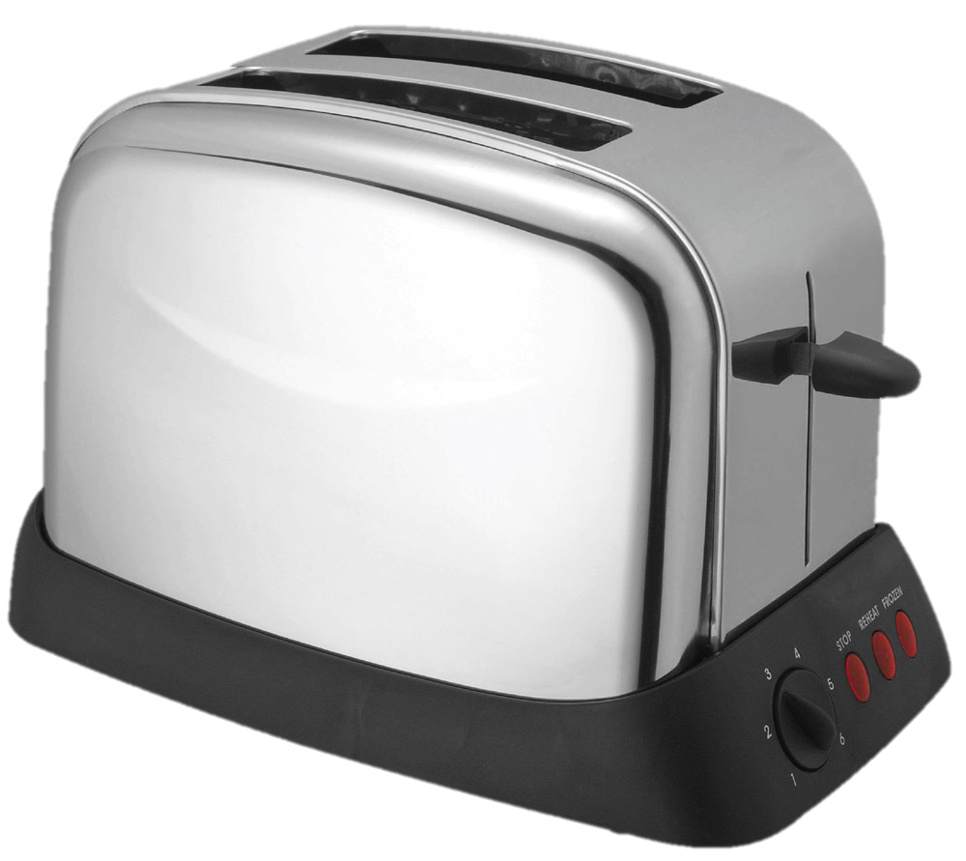
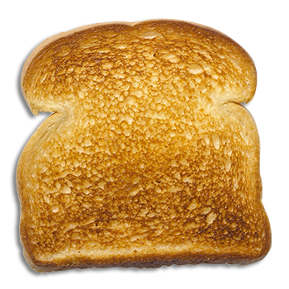
Breakfast App
Notes:
Make the piece of toast pop out of the toaster when you click on the toaster

Slide 3
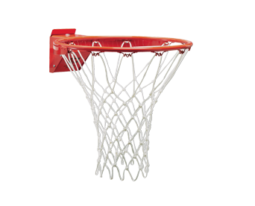
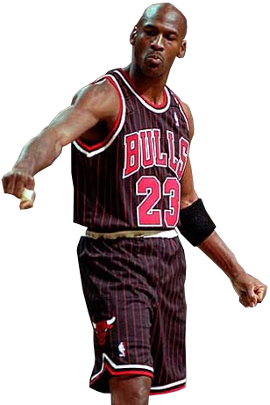
Swoosh
Notes:
Make the ball bounce when you clock on the button

Slide 4
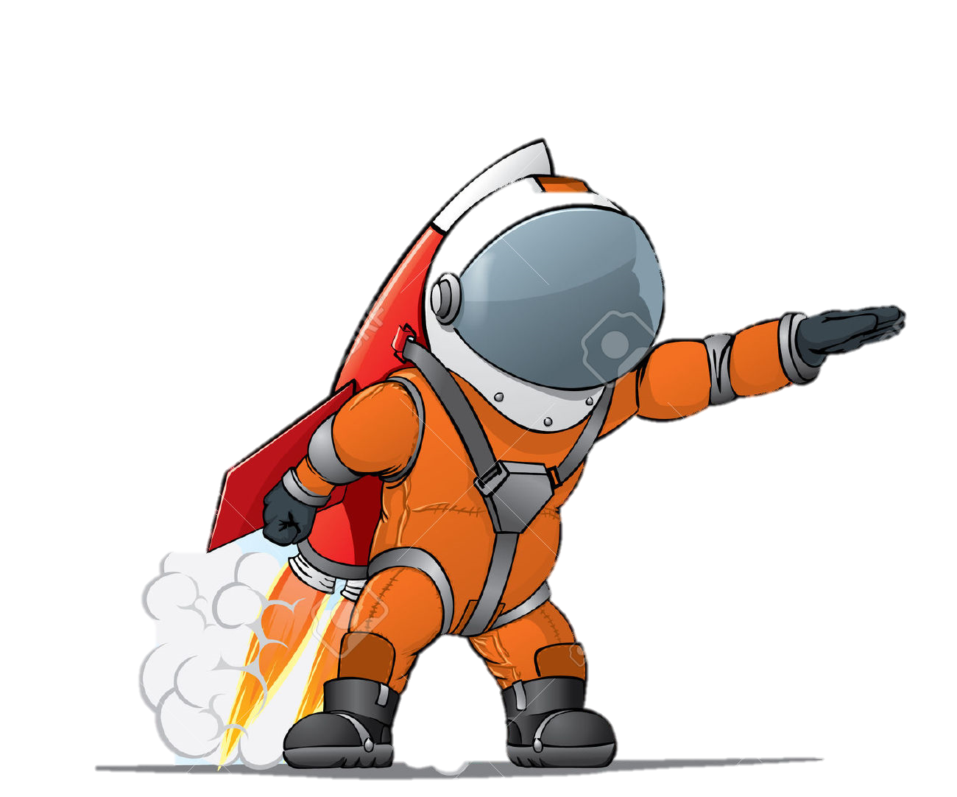
What do Astronauts do when they are Angry?????
They Blast Off!
Notes:
Make the Call out appear when you click on the astronaut

Slide 5
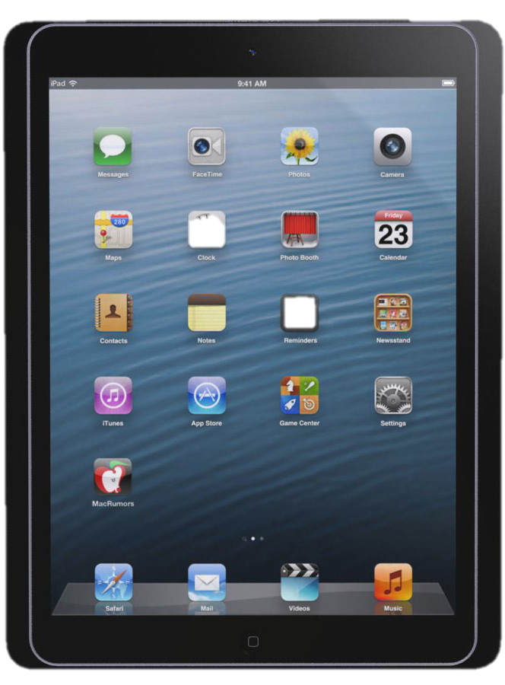
Notes:
Create Your Own Button! Make an app appear on the ipad when you click on it. Or create one of your choice.

